Slide 1
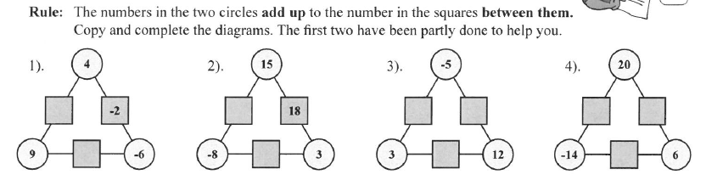
Topic : Worded Questions
24
7
30
Date
EQ : How do we answer worded Questions?
While you are waiting……

Slide 2
Topic : Worded Questions
24
7
30
Date
EQ : How do we answer worded Questions?
While you are waiting……
13
7
-2
7
6
26
3
-5
15
-8

Slide 3
From last lesson.
a) 2 x -4 =
b) -40 ÷ 8 =
c) -1000000 x -3 =
d) 80 ÷ 2 =
e) -80 ÷ -4 =
f) 16 - + 20 =
g) -8 + -10 =
h) 7 - - 9 =
g) - 2 + + 8 =

Slide 4
Topic : Worded Questions
24
7
30
Date
EQ : How do we answer worded Questions?
C - Circle the numbers in the question
U - Underline the question
B - Box the keywords
E - Eliminate the unnecessary information
S - Solve the question with working out
What is C.U.B.E.S?
Example
Jane spent $42 for shoes she also bought a new hat, sunglasses and a new shirt. This was $14 less than she spent for the new shirt. How much was the shirt?
42 = shirt - 14
42 + 14 = shirt
56 = shirt The shirt cost $56

Slide 5
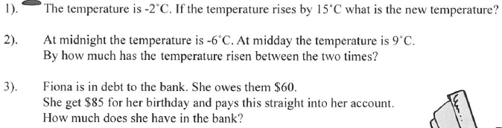
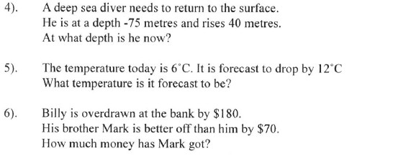

Slide 6
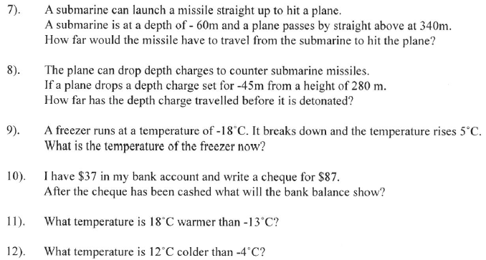

Slide 7
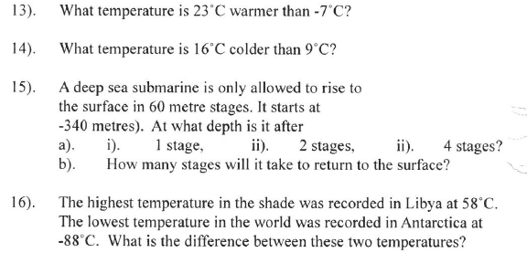

Slide 8
Learning Log Over the past week we have looked at; BIMDAS Adding and Subtracting positive and negative numbers Multiplying and dividing positive and negative numbers Fill in the learning log entry on what you learned on these subjects for the week and place it at the back of your INB.

Slide 9
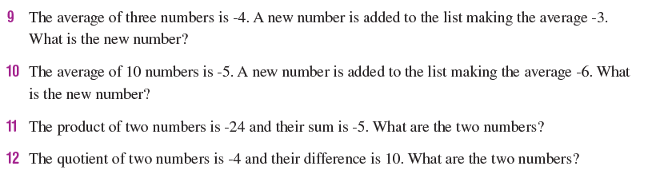
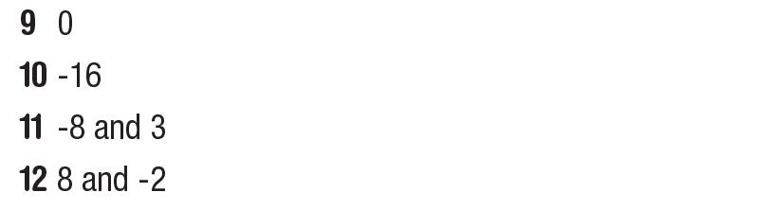
Extension/Extra Questions

Slide 10
